Slide 1

LEARNING MANAGEMENT SYSTEM
Name: Ifthakharul alam shuvo
ID: 1530421045

Slide 2
Introduction
Learning management systems (LMS) can be defined as a suite of
services designed to deliver,track, report on and administer learning content,
student progress and student interactions. The varsity admin can control the
system. The importance of these systems is growing as far as terms such as
internet-based educational system, educational service Provider, and
Distance learning or On-demand education are becoming popular. On this
modern era and pandemic situation there is necessity of online learning
platform based on Bangladesh curriculum. Most of the educational institution
doesn’t have any online learning management system. Some of them
owned a system but which are not fully function and effective for both
students and faculty members. On this pandemic situation numerous students
regular educational work flow is getting hampered and lack of a systemic management
system, institutions are unable to track/follow their protocol and facing difficulty
manage their large number of students.Under this circumstance, there is a necessity
to build such a kind of advance learning management system which will be universal
for all institution, connect everything on one place and full fill their basic core.

Slide 3
Faculty
we are making a universal learning management system. Here faculty role is one of the vital role out of four roles of this system. Any institution which have access in this system their tutors need to register in this system. Then instructor can use the features of this system. After the login of instructors they can see a dashboard Containing various features.
here instructor can take classes through video calls.

Slide 4
Features
I. My courses: In this function instructor can see which courses and which sections
he is taking in a particular semester .
II. Class time: Here instructor can watch his class timing with weekly days.
II. Manual attendance: This function will allow to take attendance manually and
show the total present and absent student number. III. Notification: Here the system will shoe all kind of notification for the instructor. IV. Sent notification: From here instructor can send any kind of notification to the students. V. Upload grade : This function will give instructor upload grade features for all the students in his particular course section. VI. Assign work: Here instructor can assign any kind of cw or hw for the students.
VII. Upload file: Here instructor can upload any kind of reading materials. VIII. View assignment: In this function instructor can view the submitted,late submitted or missing assignment with name and id of any students. IX. My profile: This function will show details of any particular instructor.

Slide 5
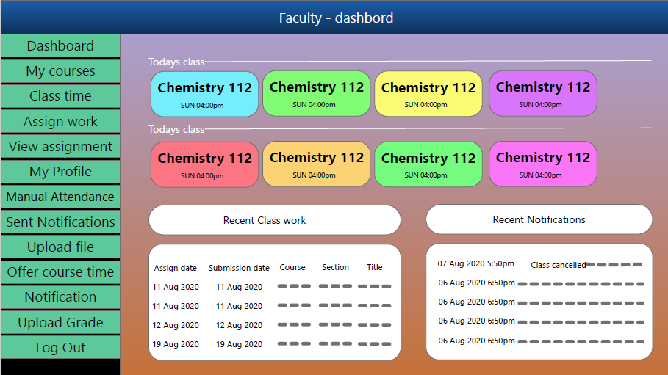
X. Offer course time: This feature will allow the instructor to set his preferable time for the course to the institution. XI. Dashboard: It will show particular days classes, recent class work, recent notifications.

Slide 6
Institution
we are making a universal learning management system. Here institution authority role is the main role of this system. Institution will register first
in this system. Institution will monitor the work of students and istructors.
Institution will assign the instructor and sum up their role.

Slide 7
Features
courses: In this function institution will assign courses to the instructor, students and can
Can manage all courses and theris section and time also.
II. Faculty: Here institution can add faculty, delete faculty, modify faculty information.
III. Student: Here institution can add student, delete student, modify student information. IV. Sent notification: From here institution can notify all students and instructor or any
particular student or instructor. V. Grades : This fuction will provide the grade of all student and Institution can watch any
particular students grade also.
VI. Assign courses: Here institution can assign any course to the student and instructors.
VII. Advising rules: Here institution can set the rules of course registration. VIII. Result backup: Here institution will have backup for all results of every students. IX. University profile: This function will show details of that institution which registered
into the system.
X. Add role: Here institution can assign the role for any instructor.

Slide 8
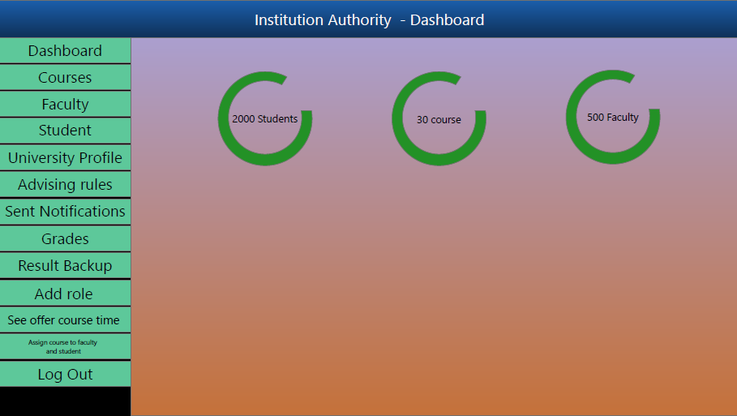
XI. See offer course time: Here institution can see the desired courses and their time of
Any student’s or instructor’s. XII. Dashboard: It will show all students , courses and instructor under the institution.

Slide 9
Development Technology
HTML, CSS, Bootstrap
Laravel, JavaScript, Ajax, Jquery
MySQL

